Slide 1
Heat Transfer (CH21204)
Conduction and Radiation
Class –XII
Radiation Heat Transfer

Slide 2
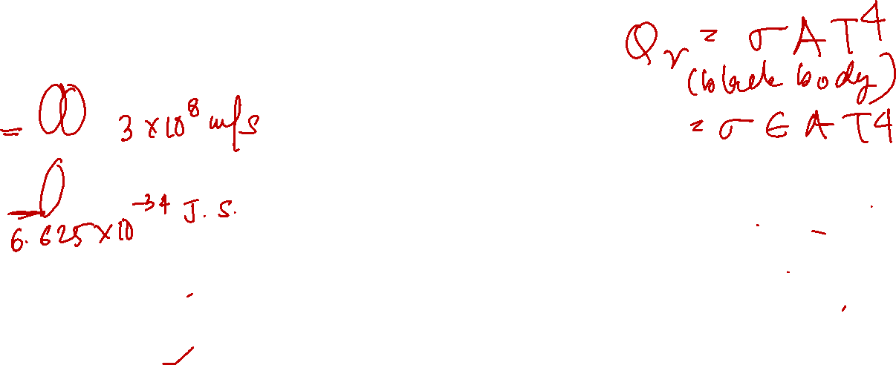
Spectrum of Electromagnetic Radiation
Thermal radiation is electromagnetic radiation emitted by a body as a result of its temperature

Slide 3
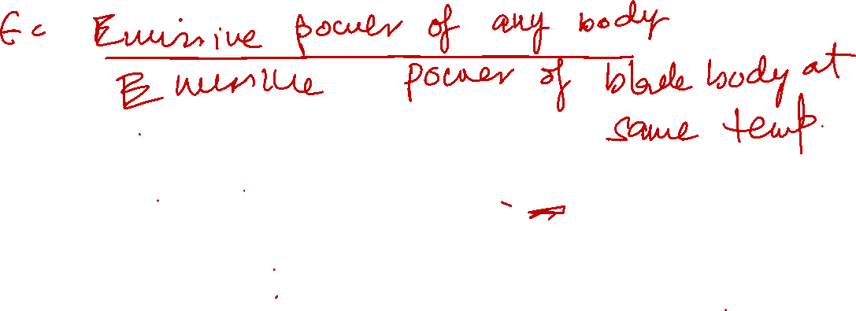
Radiation cooling of a hot surface
Emissive Power
Rate (W/m²) at which radiation is emitted from surface per unit surface area (per unit time) over all wavelengths and from all directions
Total hemispherical emissive power

Slide 4
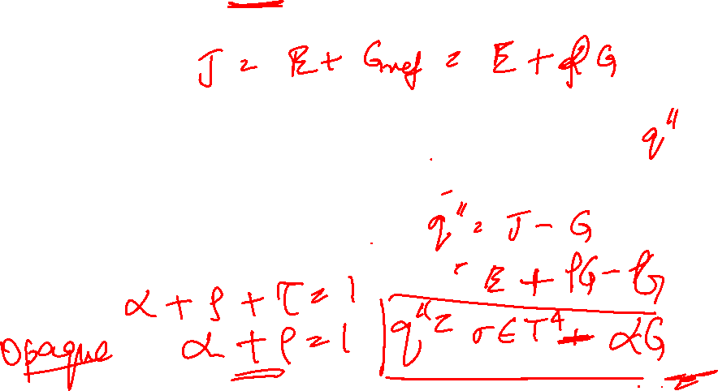
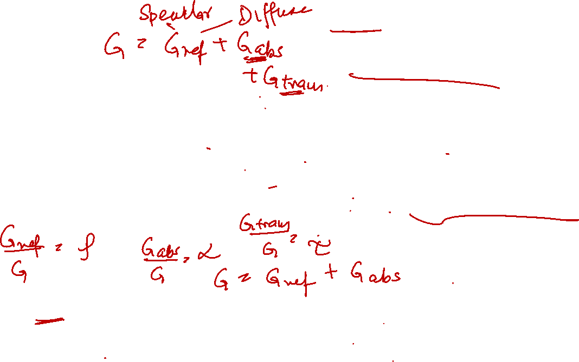
Radiation at a surface
Irradiation (G) – Rate at which radiation is incident upon surface per unit area over all wavelengths and from all directions
Radiosity (W/m²) of a surface accounts for all radiant energy leaving surface per unit area
Net radiative flux from surface (W/m²) = Outgoing radiation - Incoming radiation
Semi-transparent medium

Slide 5
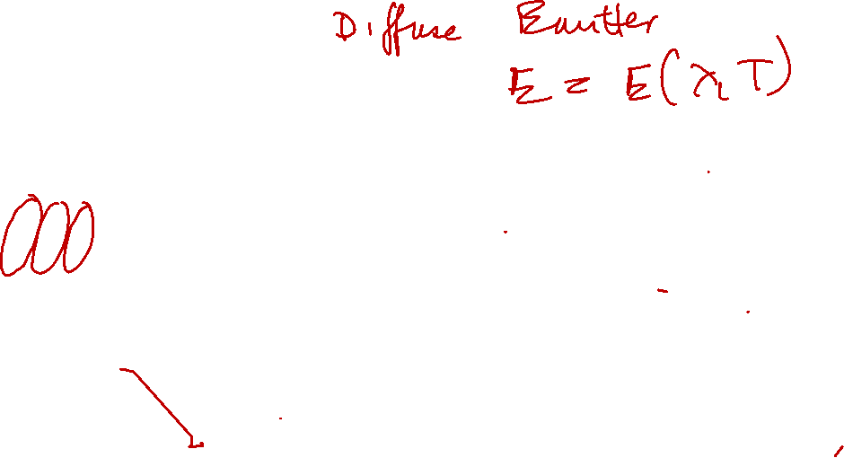
Characteristics of thermal radiation
Volumetric phenomena but treated as surface phenomena
Spectral nature
(Spectral distribution vary with nature and temperature of surface)
Directionality
Thus, E = E(λ, θ, T)
Diffuse emitter

Slide 6
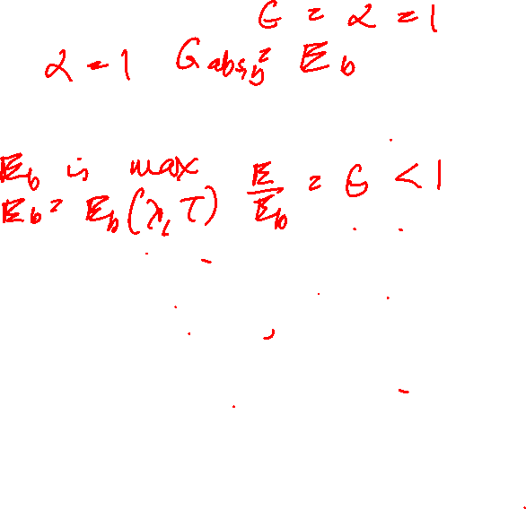
Characteristics of an isothermal black body
Absorbs all incident radiation regardless of wavelength and direction.
At a particular wavelength and temperature, no surface can emit more energy than a black body
Diffuse emitter, Eb ≠ Eb( θ)
Diffuse irradiation of interior surface
Isothermal surface
(Cavity at uniform temperature)
- Ideal emitter and absorber, ε =1; α =1
- Serves as a standard against which the radiative properties of actual surfaces are compared
Black body emission exists within cavity irrespective of whether cavity is highly reflecting or absorbing.

Slide 7
Irradiation of any body inside the enclosure may be approximated as equal to emission from a black body at the enclosure surface temperature.
Isothermal surface
- Ideal emitter and absorber, ε =1; α =1
- Serves as a standard against which the radiative properties of actual surfaces are compared
Black body emission exists within cavity irrespective of whether cavity is highly reflecting or absorbing.

Slide 8
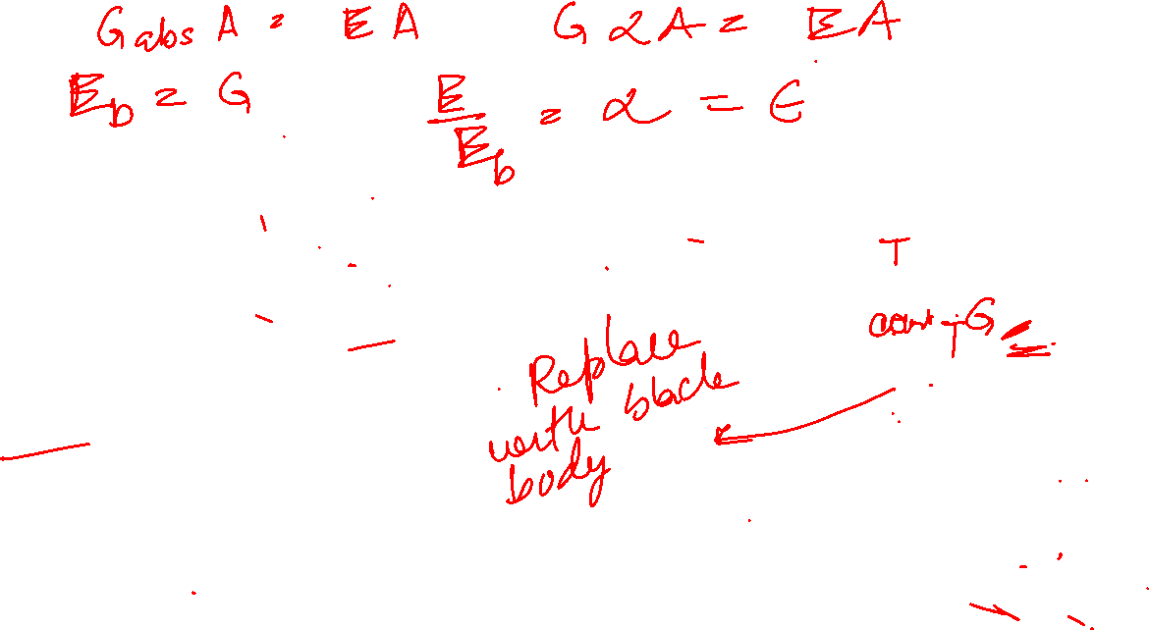
Relation between emissive power and material properties
Kirchoff’s Law
Emissivity = radiation emiited by surface/ Radiation emitted by black body at same T

Slide 9

Total hemispherical emissive power(E, W/m² )
Rate (W/m²) at which radiation is emitted from surface per unit area per unit time at all possible wavelengths and in all possible directions, i.e. E = E(λ, θ, T)
But radiation emitted by a blackbody is a function of wavelength & temperature Eb = Eb(λ, T);
but independent of direction, Eb ≠ Eb( θ)
Diffuse Emitter
Blackbody spectral intensity from Planck’s distribution law
Emission from a differential element of area dA1 into a hypothetical hemisphere centred at a point on dA1
T in Kelvin

Slide 10
Planck’s distribution/ Planck’s law
Emitted radiation varies continuously with wavelength
At any wavelength, magnitude of emitted radiation increases with increasing temperature
Spectral region in which radiation is concentrated depends on temperature; comparatively more radiation appearing at shorter wavelengths at higher temperatures
Significant fraction of radiation emitted by sun (approximated as a blackbody at 5800K is in the visible region of the spectrum
For T≤ 800K, emission is predominantly in infra red
region of spectrum and is not visible to the eye
Blackbody spectral distribution has a maximum,
λmax =fn (T)

Slide 11
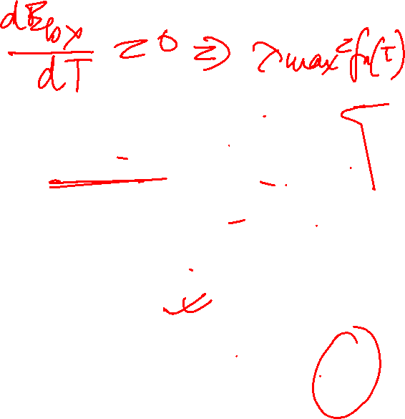
Blackbody emissive power as function of wavelength and temperature
Wien’s Displacement Law
Stefan Boltzmann law

Slide 12
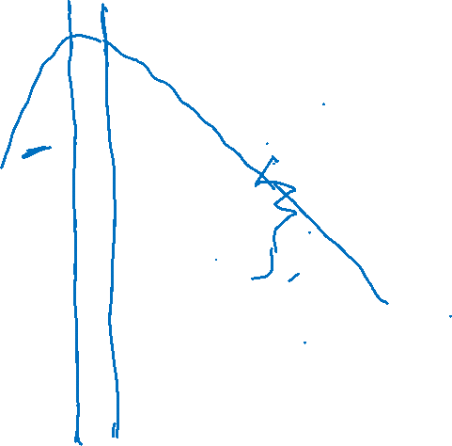
Change in colour of body when heated

Slide 13
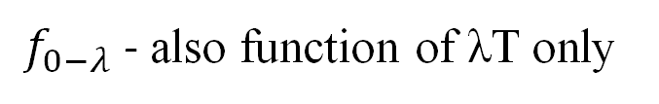
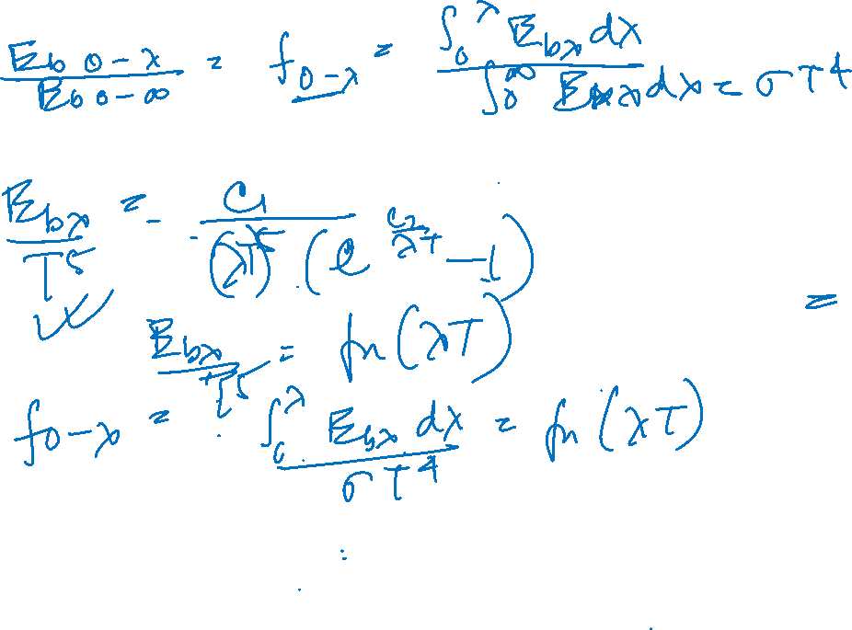
Band emission of black body
To account for spectral effects, often necessary to know fraction of total emission from a black body in a certain wavelength interval (band) at a particular temperature
is exclusive function of λT (wavelength-temperature product)
$f_{0−λ}$ - also function of λT only

Slide 14
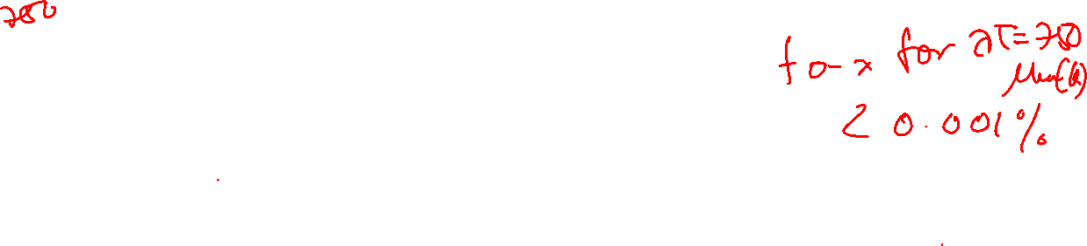

Fraction of blackbody radiation in wavelength interval

Slide 15
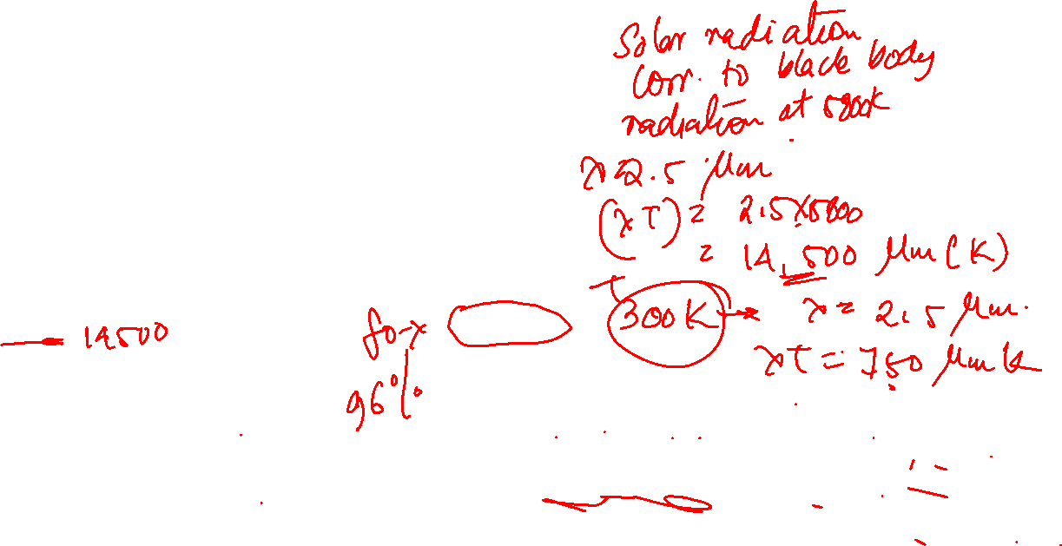
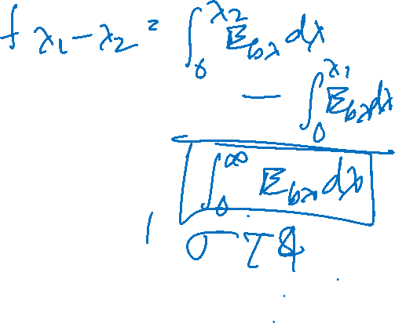
Glass is essentially transparent to visible light but almost totally opaque to thermal radiation emitted at ordinary room temperature

Slide 16
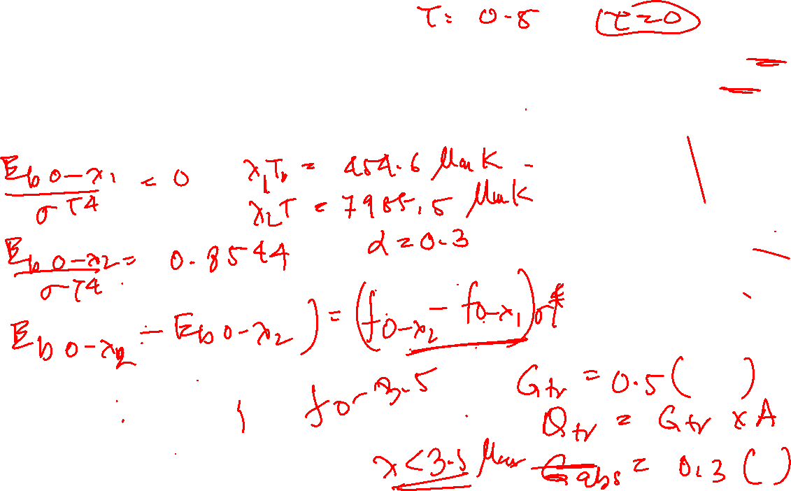
Example Problem
A square glass plate of 30 cm side is used to view radiation from a furnace. τ of glass is 0.5 from 0.2 to 3.5 µm and is zero elsewhere. The emissivity (€) may be assumed to be 0.3 up to 3.5 µm and 0.9 above that. Assuming that the furnace is a blackbody at 3000C, estimate the energy absorbed in the glass and the energy transmitted.

Slide 17
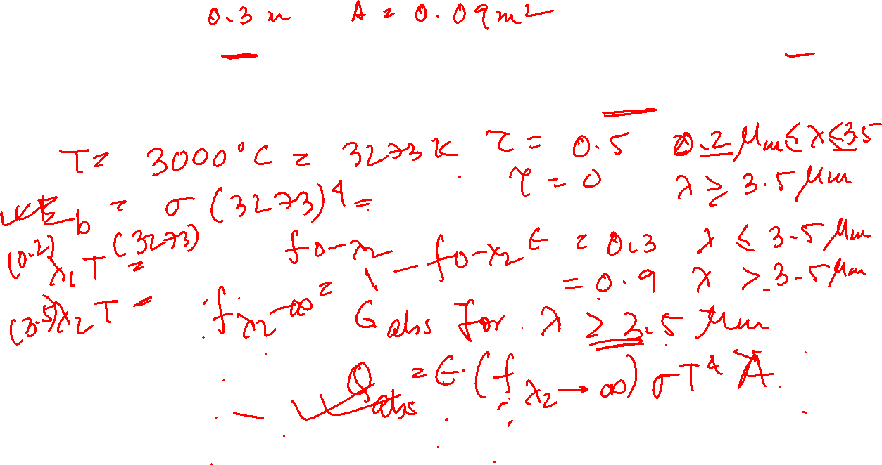
Example Problem
A square glass plate of 30 cm side is used to view radiation from a furnace. τ of glass is 0.5 from 0.2 to 3.5 µm and is zero elsewhere. The emissivity (€) may be assumed to be 0.3 up to 3.5 µm and 0.9 above that. Assuming that the furnace is a blackbody at 3000C, estimate the energy absorbed in the glass and the energy transmitted.

Slide 18
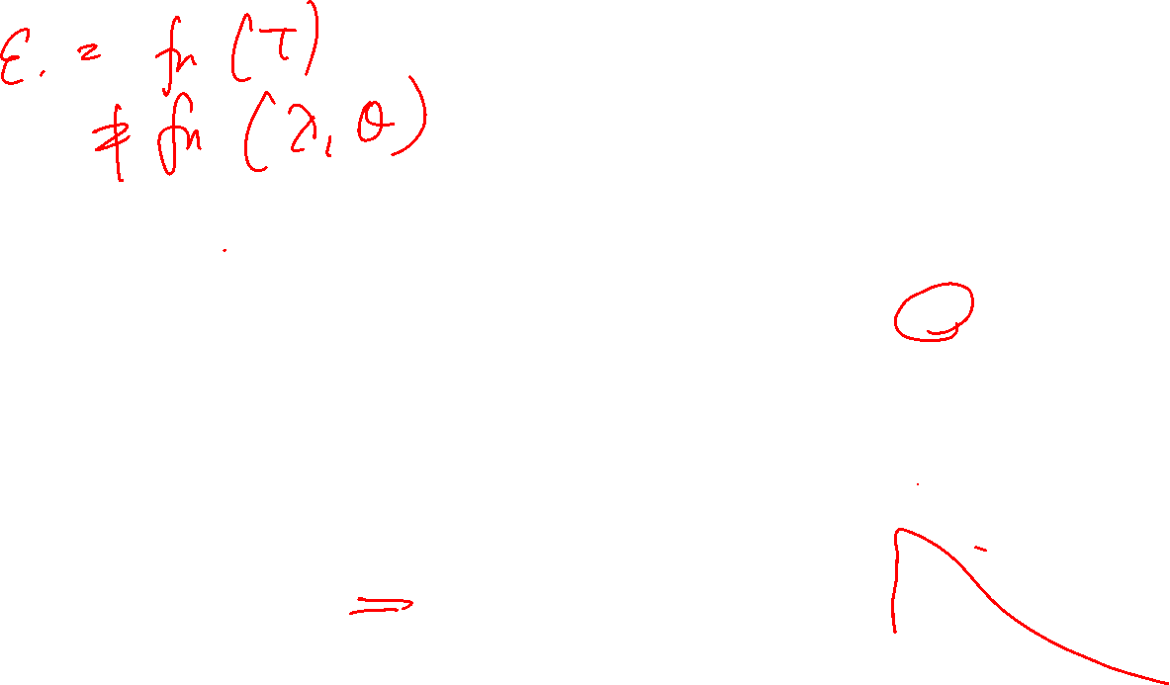
Emission from a real surface
Comparison of emissive power of ideal black bodies, gray bodies and real surface
Gray body
Monochromatic emissivity of body is independent of wavelength

Slide 19
Temperature dependence of total normal emissivity of selected materials
Representative values of total normal emissivity

Slide 20
Area elements used in deriving view factor/shape factor/angle factor/configuration factor
Fm-n -Fraction of energy leaving surface m and reaching surface n
Black body
T2
T1
Under thermal equilibrium -
Reciprocity relation
Valid for other surfaces as long as diffuse radiation is involved

Slide 21
Fm-n
In general function of -
Shape of two bodies m and n
Distance between bodies, m and n
Orientation of 2 bodies with respect to each other

Slide 22
Gray body
Monochromatic emissivity of body is independent of wavelength

Slide 23

Blackbody emissive power as function of wavelength and temperature
Wien’s Displacement Law

